Slide 1
Churn Prediction Project
POC – Customer Analytics
January 3th, 2018
Richard Vogg

Slide 2

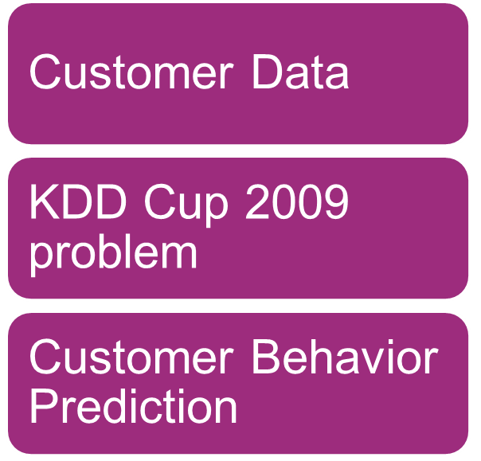
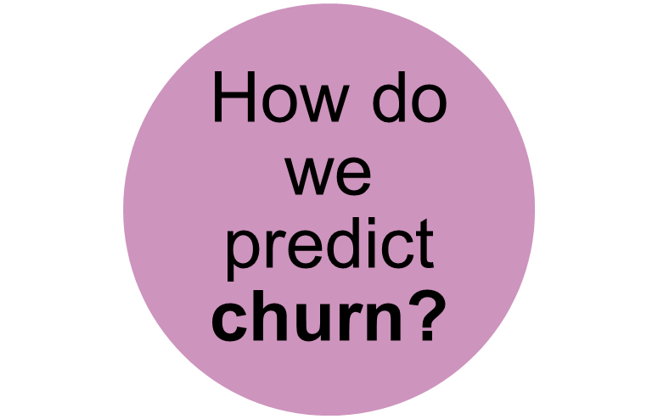
The Context

Slide 3
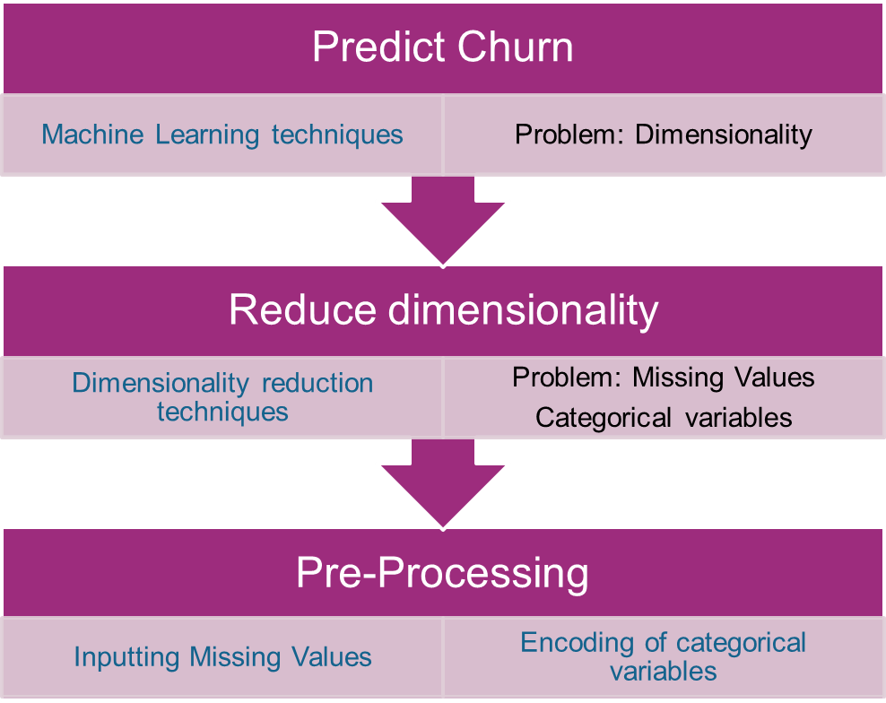
Challenges and Solutions
Variables | Large | Small
Numerical | 14740 | 190
Categorical | 260 | 40

Slide 4
The Workflow
Preprocessing
Dimensionality Reduction
Classification
Gradient Boosting Trees
One-Hot-Encoding
Missing Value Filter
Principal Component Analysis
Random Forest
Data
Binary Encoding
High Correlation Filter
Logistic Regression
Feature Importance Ranking
Neural Networks
Missing Values Imputation
Low Variance Filter
Support Vector Machine
<number> / evalueserve.com
©2018 Evalueserve. All rights reserved.

Slide 5

The Data
Variables | Large | Small
Numerical | 14740 | 190
Categorical | 260 | 40
We have a dimensionality
problem
Notes:
garbage-in-garbage-out

Slide 6
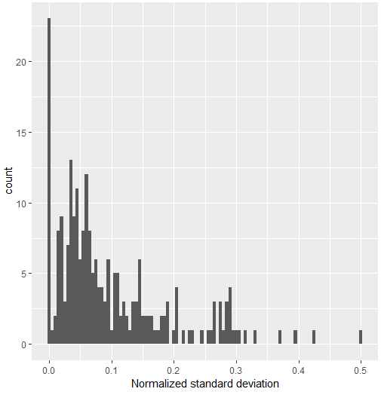
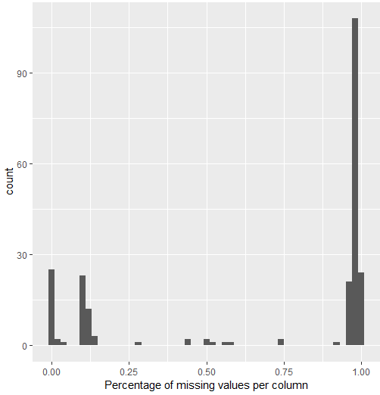
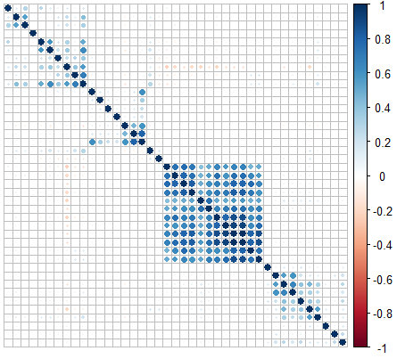
Reviewing the data
Observations
23 variable with zero standard deviation, i.e. containing just one value, or very small deviation
More than 150 variables with very high percentage (>90%) of missing values
Less than 30 variables do not have any missing values
Many correlated variables
<number> / evalueserve.com

Slide 7

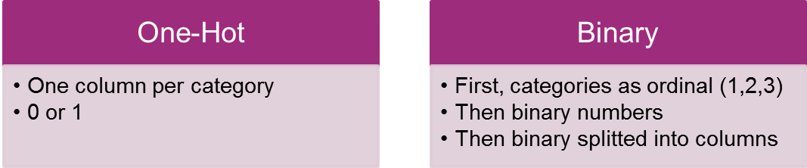
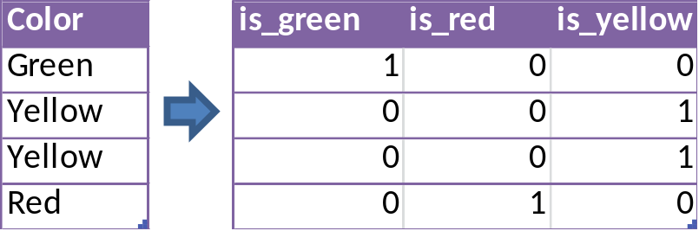
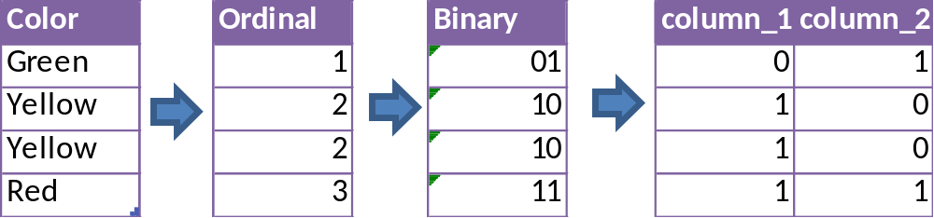
Encoding Categories
<number> / evalueserve.com

Slide 8
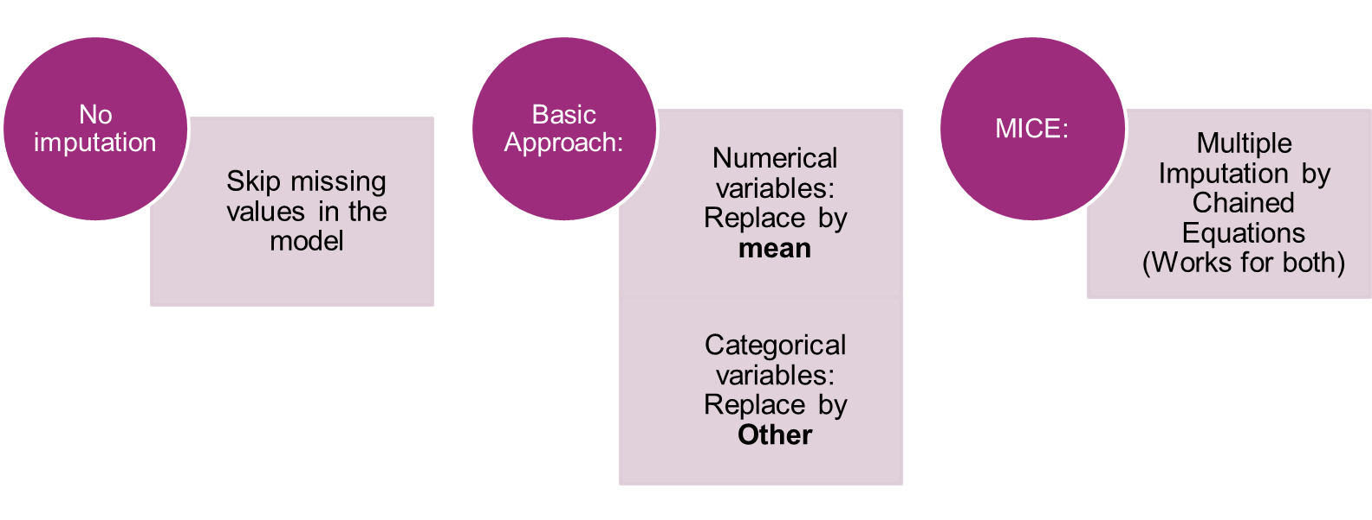
Missing Values Imputation
Best Machine Learning models do not support NA values: What should we do?
Area under the curve: 0.727

Slide 9
Low Variance filter

Slide 10
Column Filters
Purpose:
-Dimensionality Reduction
-Efficacy: Comparison vs Benchmark performance
-Efficiency: Time Management
Filters:
-Missing Values: 0 – 5 – 10 -25 – 50 %
-Low Variance: TBD
-High Correlation: 50 – 75 – 90 -100
Performance:
<3 tables, 1 per each filter outcome >

Slide 11
Thank you!
Although the information contained in this publication has been obtained from sources believed to be reliable, the author and Evalueserve disclaim all warranties as to the accuracy, completeness or adequacy of such information. Evalueserve shall have no liability for errors, omissions or inadequacies in the information contained herein or for interpretations thereof.

Slide 12
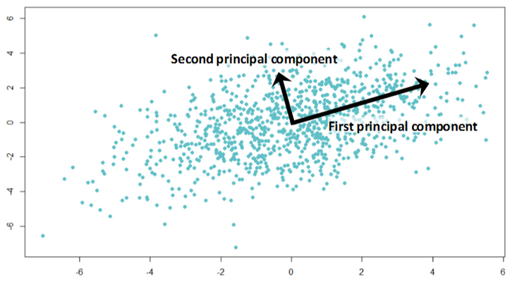
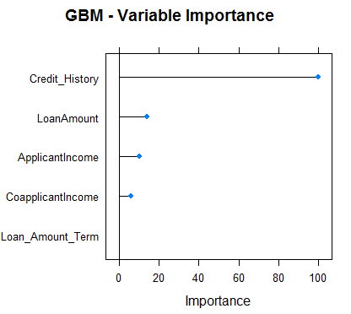
PCA vs VarImp
Principal Component Analysis (PCA)
find new axes in the data
the first principal component is along the direction with most variance among the data
each principal component is orthogonal to the others.
Advantage: dimensionality reduction without too much information loss
Disadvantage: loss of interpretability of the variables
Variable Importance Ranking (VarImp)
evaluation of the performance of each individual variable in a random forest classifier
“which trees was the variable part of, and how good did these predict?”
rank the variables along this evaluation
Advantage: qualitative measure to see the importance of each variable
Disadvantage: possible loss of variables that contain information
<number> / evalueserve.com

Slide 13
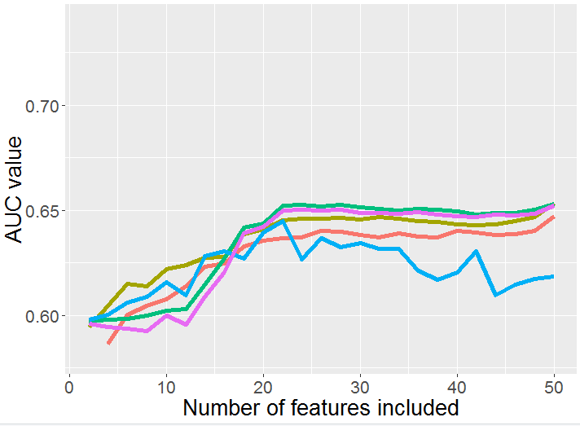
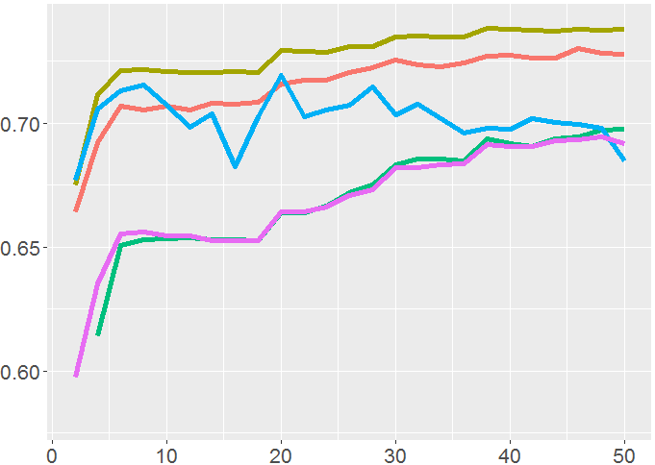
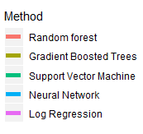
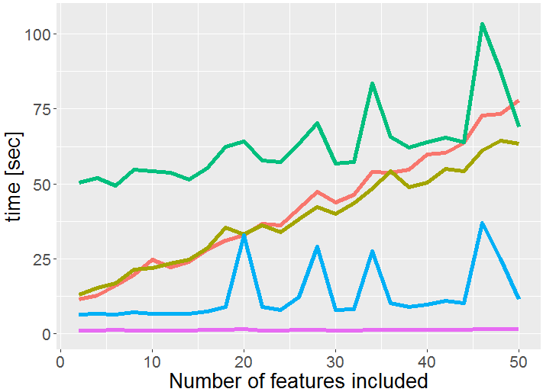
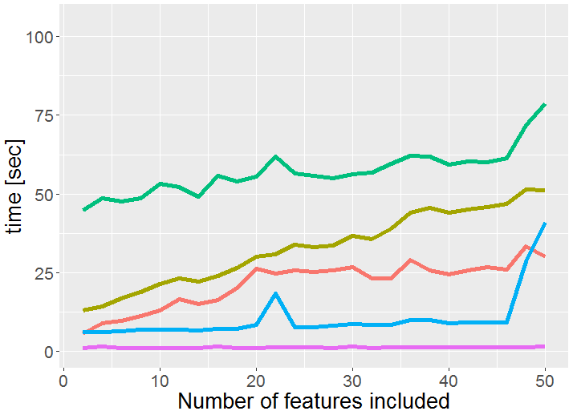
Comparing the models
PCA
VarImp
<number> / evalueserve.com

